Slide 1
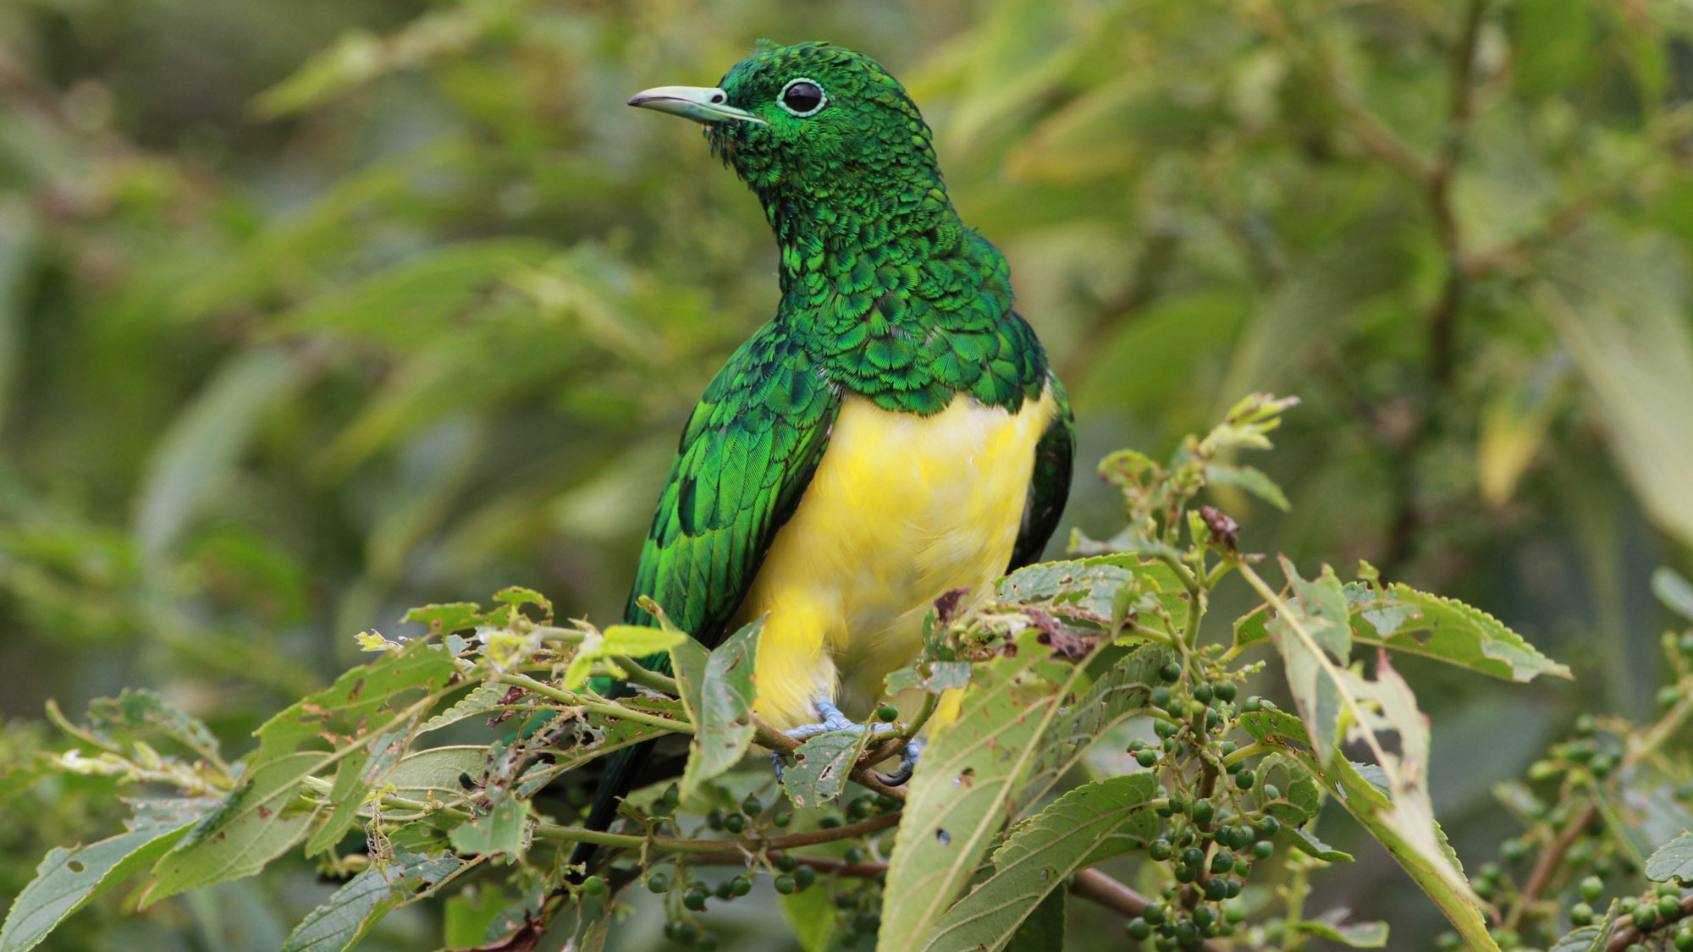

BeakPeek
Millennium
BIRDING MADE EASY AS FLY
Group 22

Slide 2
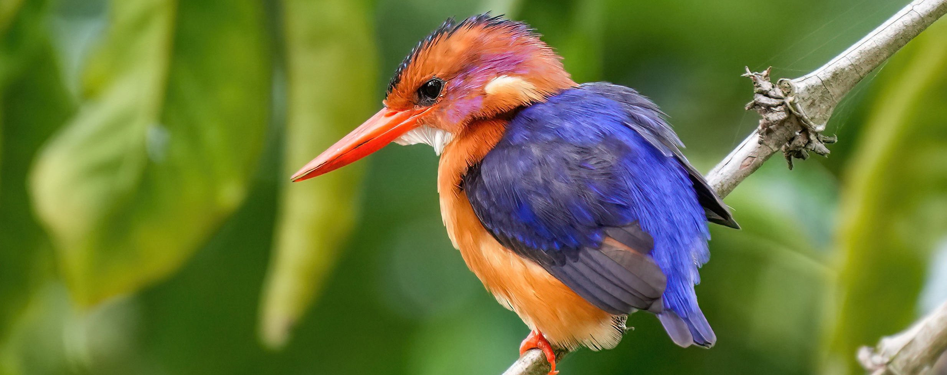

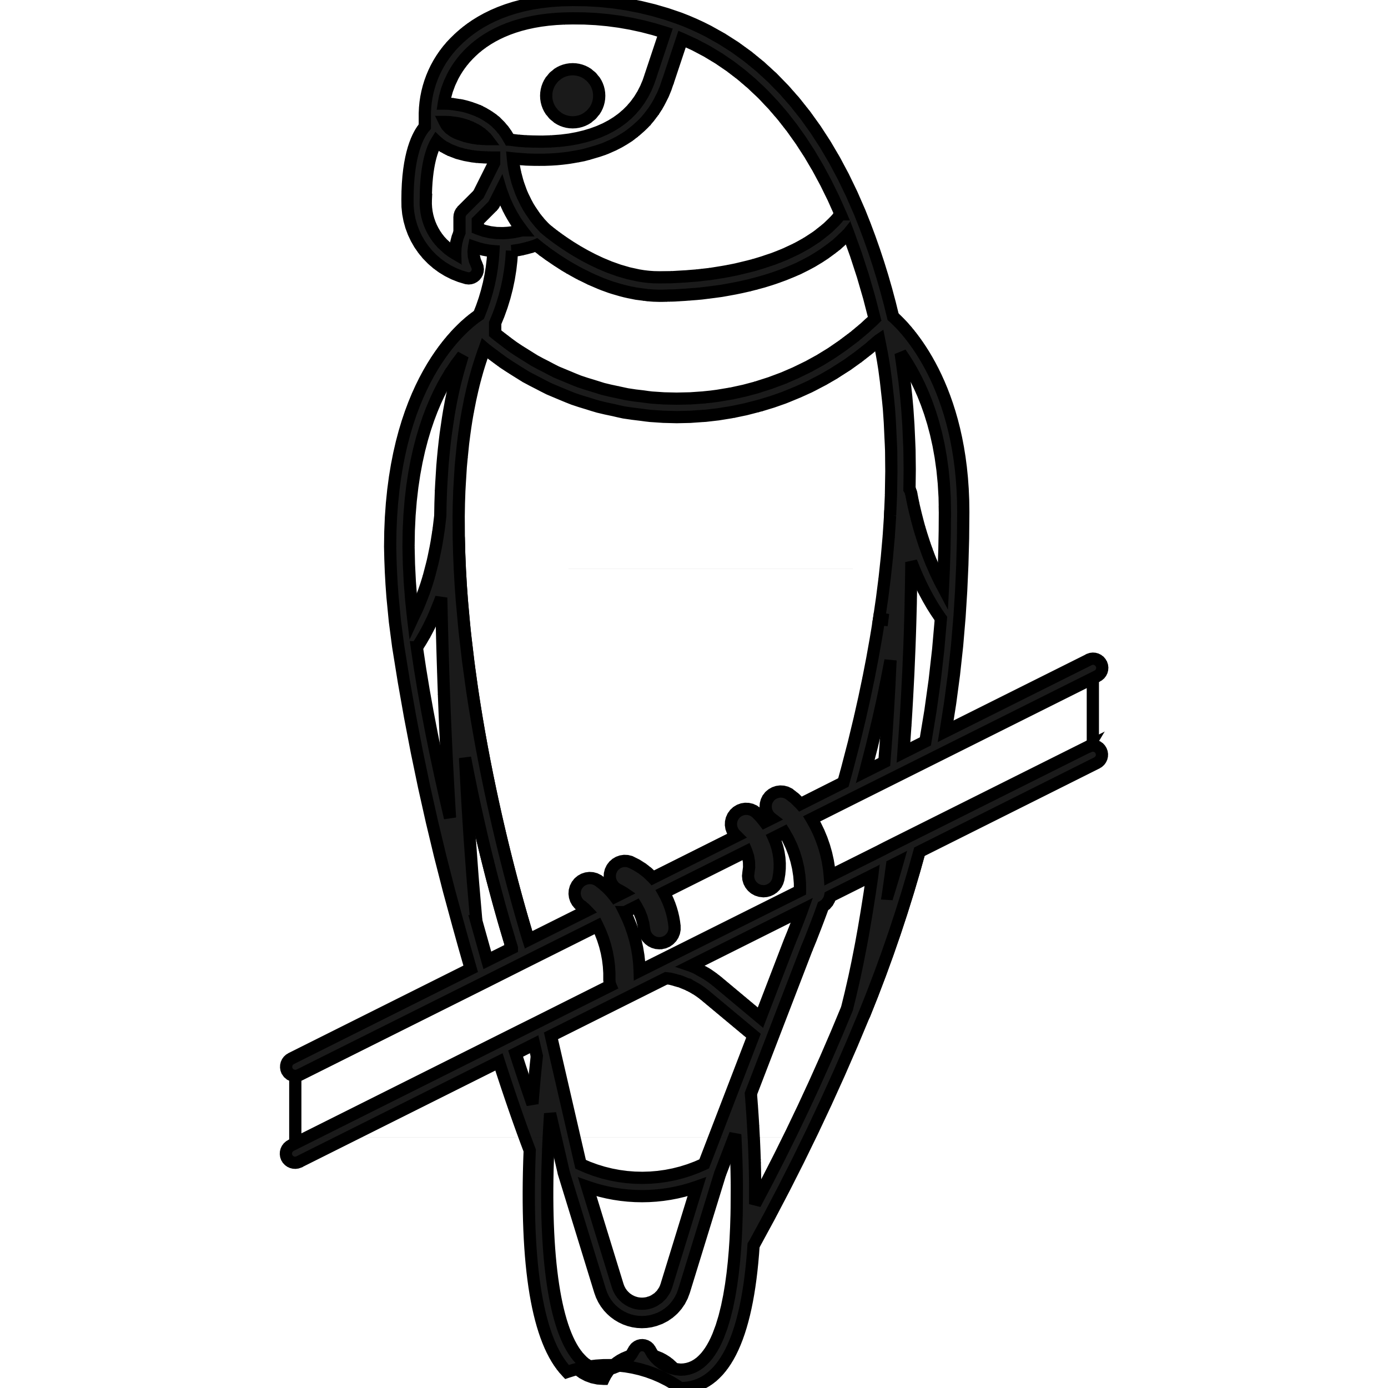

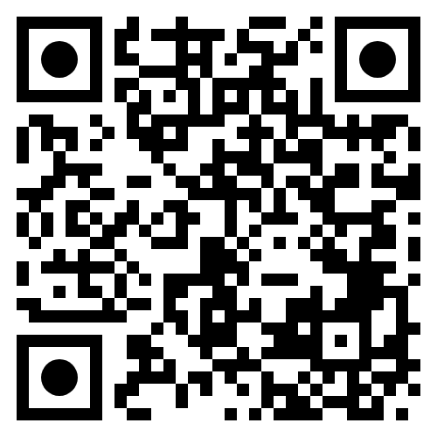
BeakPeek
Vision
Grow Birding 01
Find birds 02
Conservation 03
Grow the bird watching community in South Africa
Make it easier to not only find birds but also learn about them
Allow conservationists to easily access and understand a large amount of data
GITHUB Link
SRS LINK

Slide 3
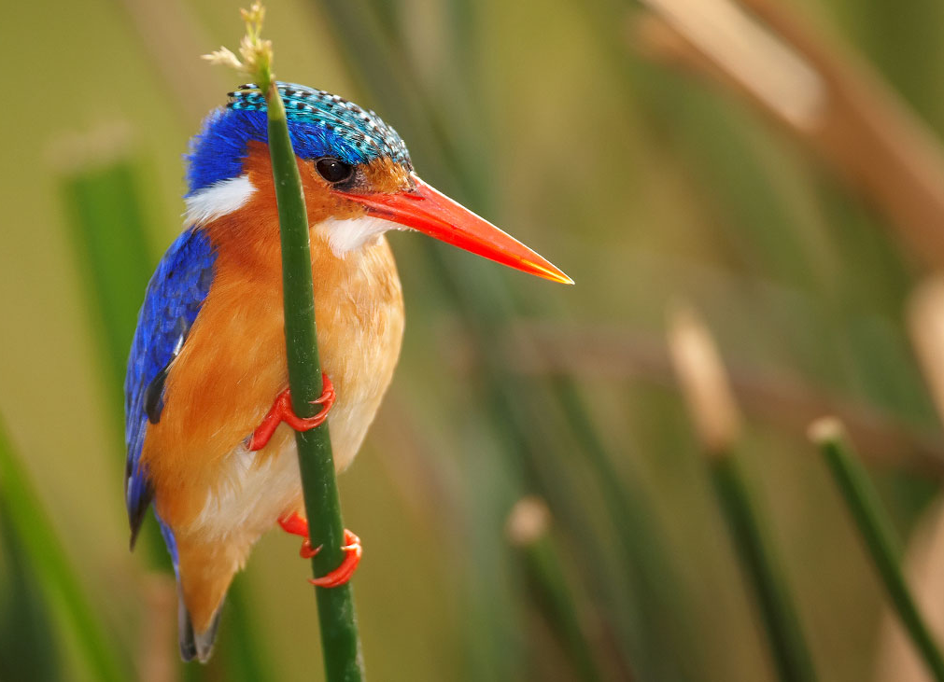
BEakPEEK
Core Quality
TESTING
usability
Performance
security

Slide 4
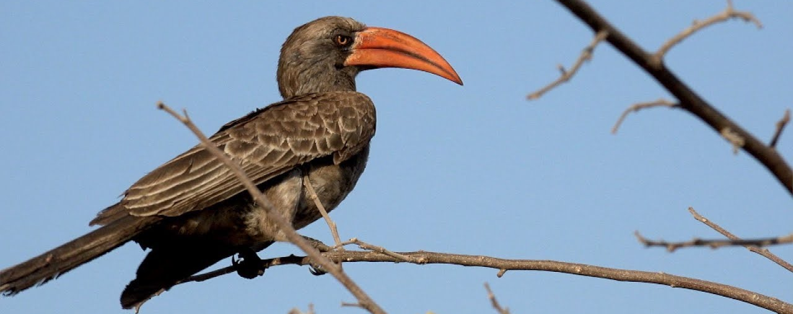

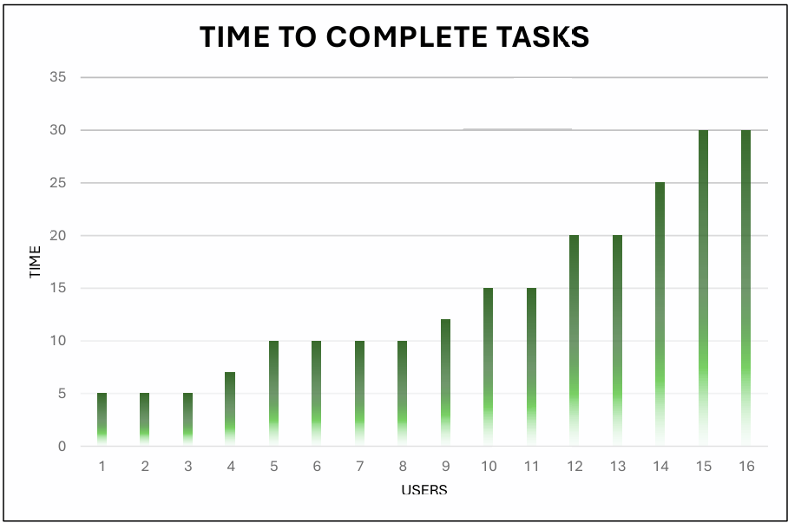
CORE Quality
Testing
Usability
Useability Test
User time to complete tasks
All comments collected and addressed
Average Time: 14,3 minutes
User Manual
Screenshots added
Common problems addressed
Notes:
Users without technical experience must be considered

Slide 5
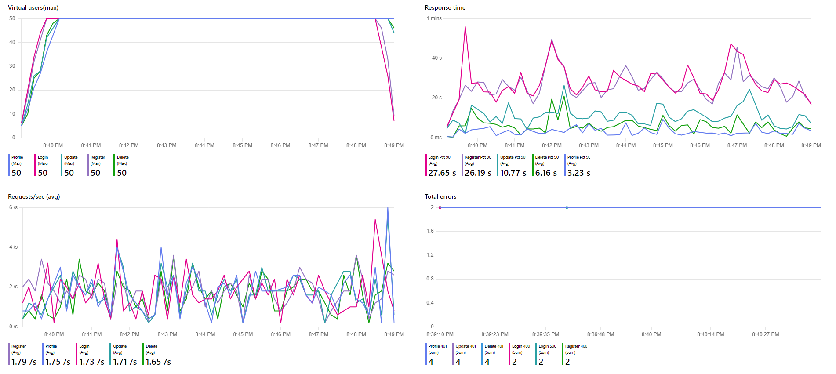
CORE Quality
Testing
Performance
1.1 Be able to handle concurrent users.
Microsoft Azure
Load Balancing

Slide 6
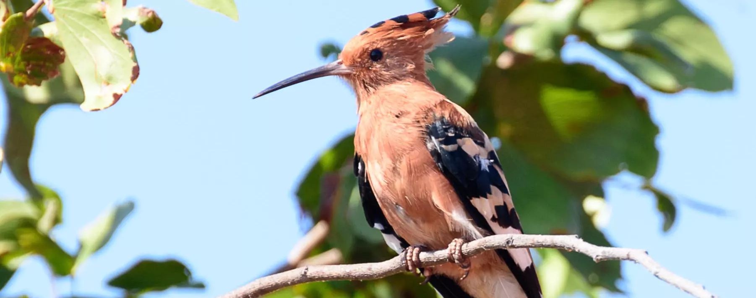
CORE Quality
Testing
Security through azure
Our security standards are achieved through the use of Microsoft Azure and Microsoft Identity.
Through them, users are automatically authorised and authenticated correctly to their respective roles. (We are using role-based access control.)
Data integrity is also ensured through the use of checksums. Audits logs are created to track administrator’s activity.
Protect user data from unauthorised:
Access
Modification
Deletion
Disclosure

Slide 7
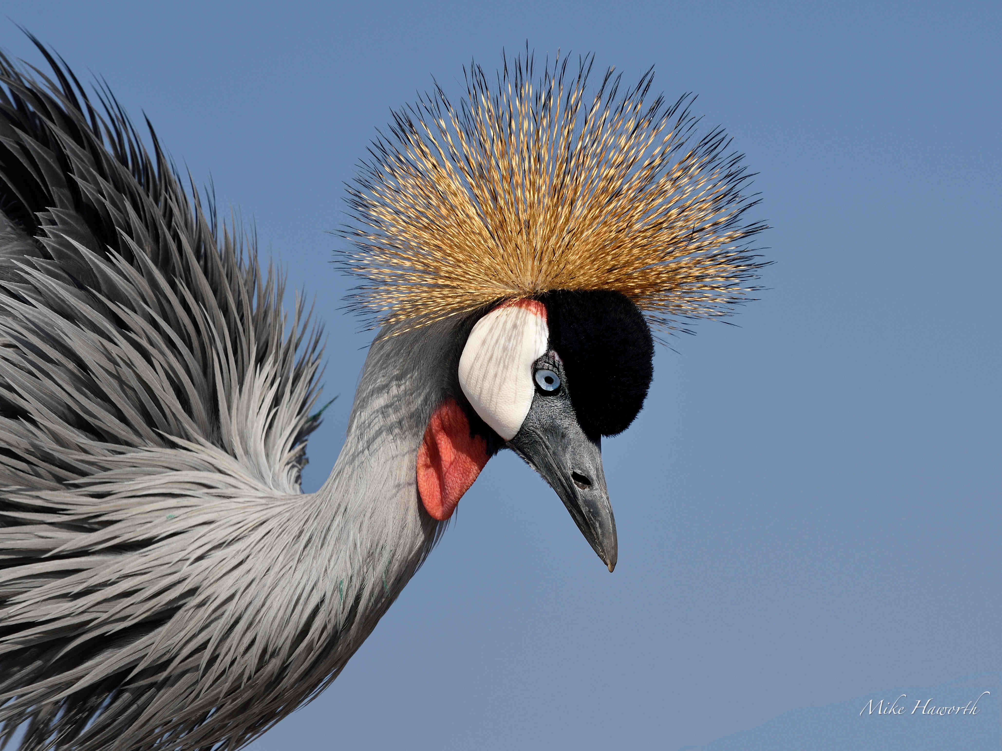


WOW Factors
Gamified
Bird Quiz
Bird Population Estimate
<10% under estimation.
All birds >1% Reporting Rate.
All birds with >1% South African Coverage.
Google Play Public Launch
Internal App Launched.
Public Publication in for review.
App Security and Performance.

Slide 8
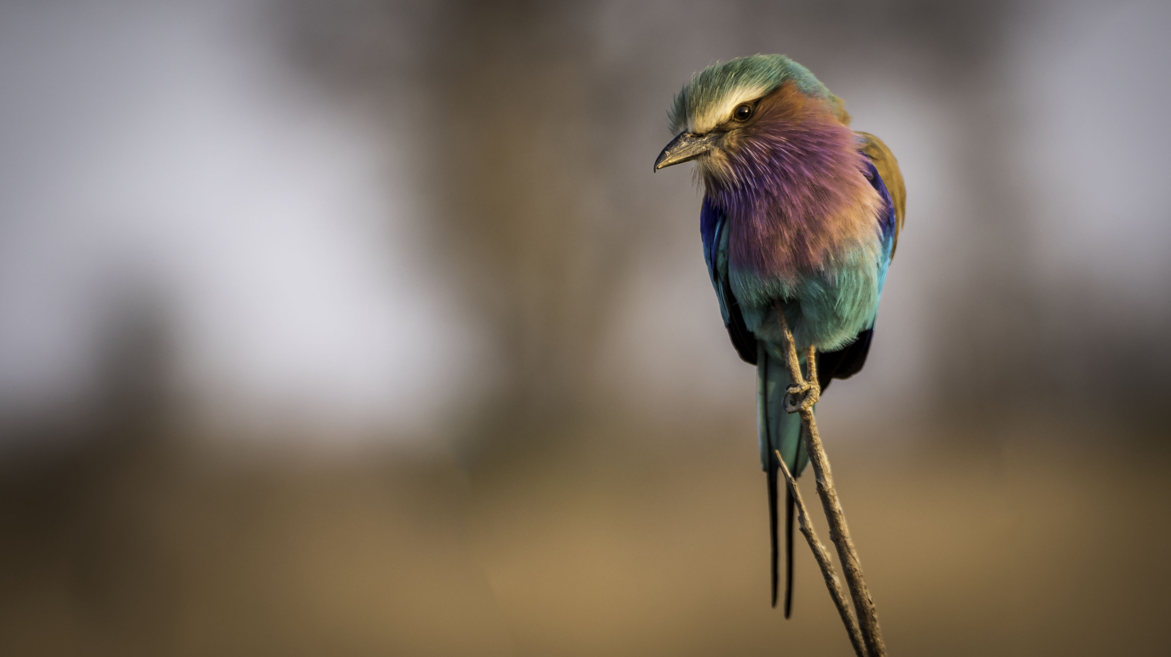
Project Management
Agile Scrum
Team Structure
Meetings:
+ Daily
+ Bi-Monthly
+ Client
+ University Mentor
+ Industry Mentor
Tickets: GitHub and Discord
Charl: Team Lead, UX, Docs, Data Science.
Justin: Integration, Fronted, Birding.
Jarod: Backend, Frontend, Offline Data.
Ivan: Backend, Online Data, DevOps.
Matthew: UI, Frontend, UX

Slide 9
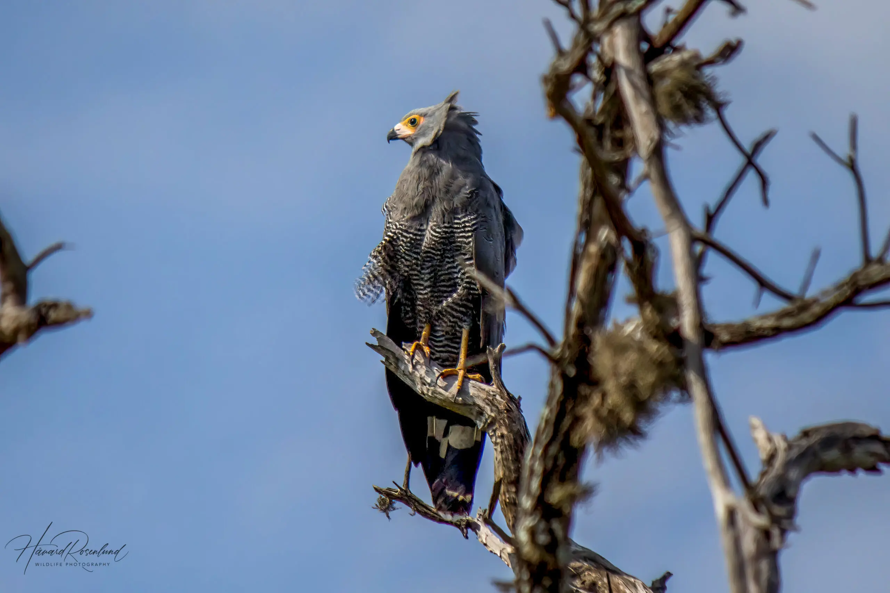
LIVE DEMO

Slide 10
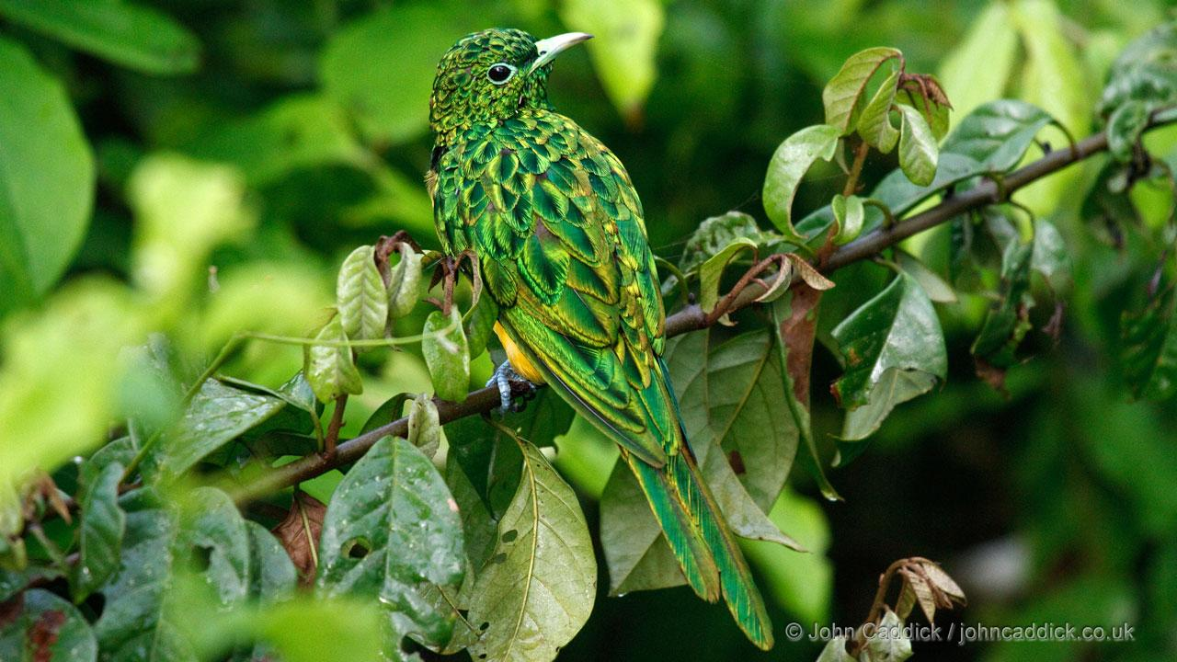
ThankYou
BeakPeek
millennium.capstone@gmail.com
Group 22
Charl Pretorius

